Slide 1



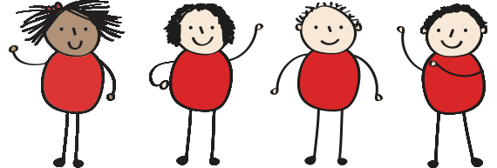
EARLY CHILDHOOD EDUCATION
SILLIMAN UNIVERSITY

Slide 2


SOCIAL STUDIES
LEARNING OUTCOMES:
Pupils will be able to describe their communities.
Pupils will be able to identify the role and importance of community helpers.
Pupils will be able to value the people in the community.

Slide 3
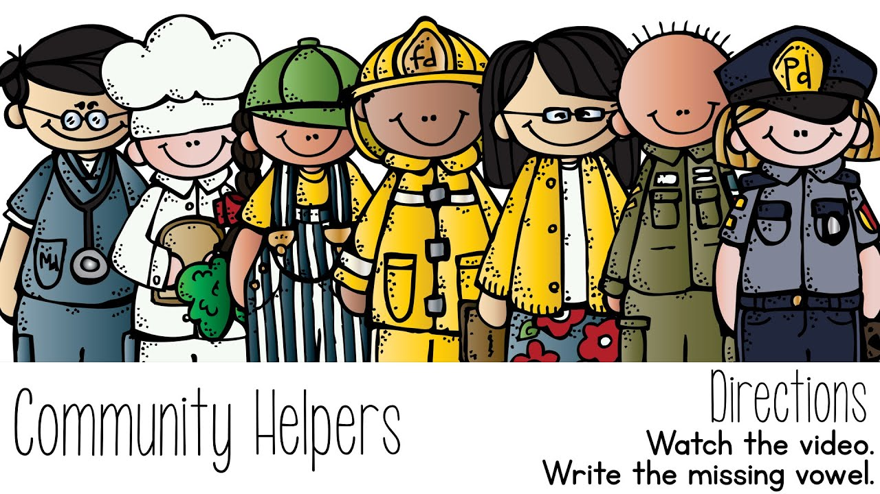
PEOPLE IN THE COMMUNITY
Occupation Song

Slide 4

PEOPLE IN THE COMMUNITY
WHAT IS A COMMUNITY HELPER?

Slide 5
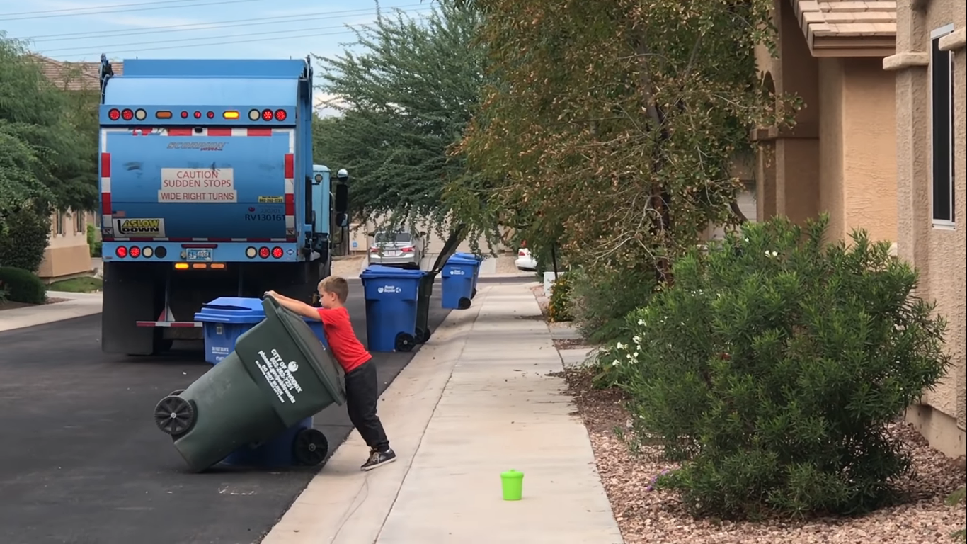
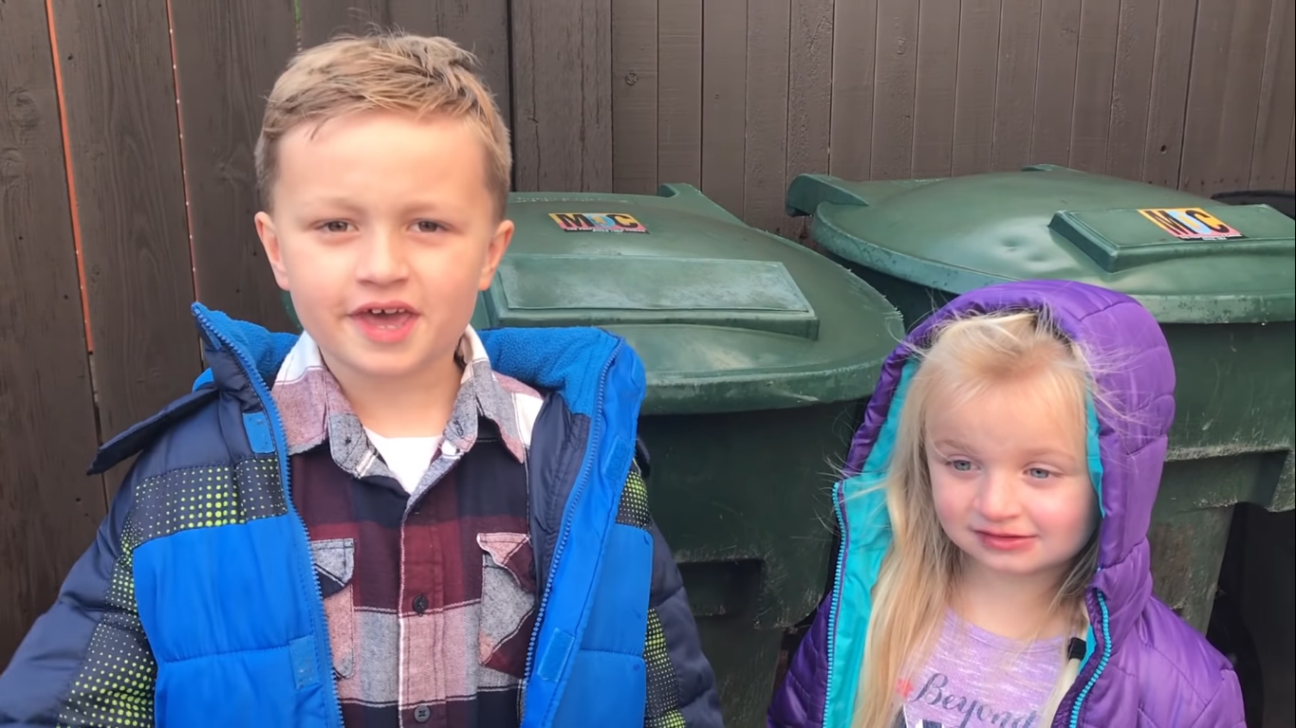
PEOPLE IN THE COMMUNITY
Roman Helps The Recycle Truck Driver

Slide 6

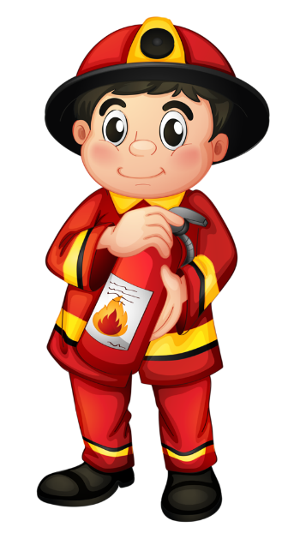
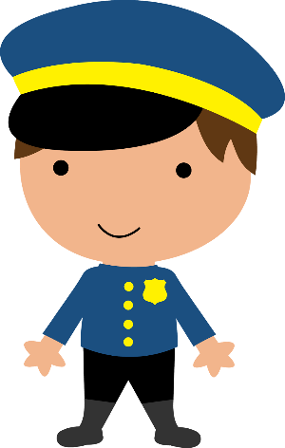
PEOPLE IN THE COMMUNITY
Community helpers are people who live and work in our communities. They do many different things to help us every day.
They provide us with goods (products we use) and services (things they do for us).

Slide 7



Some examples of community helpers are:

Slide 8
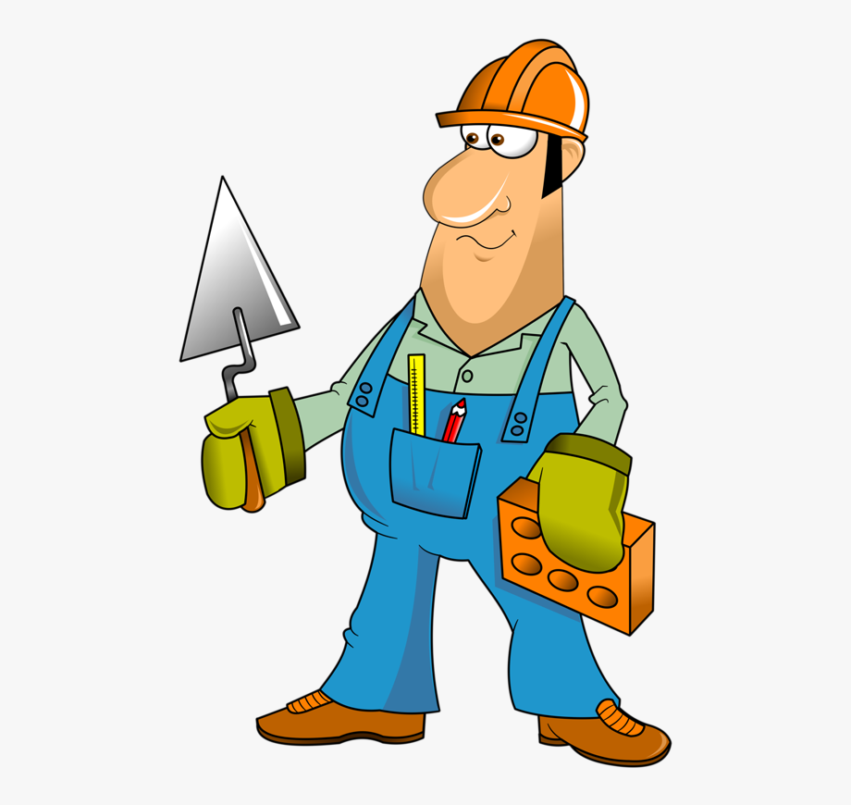
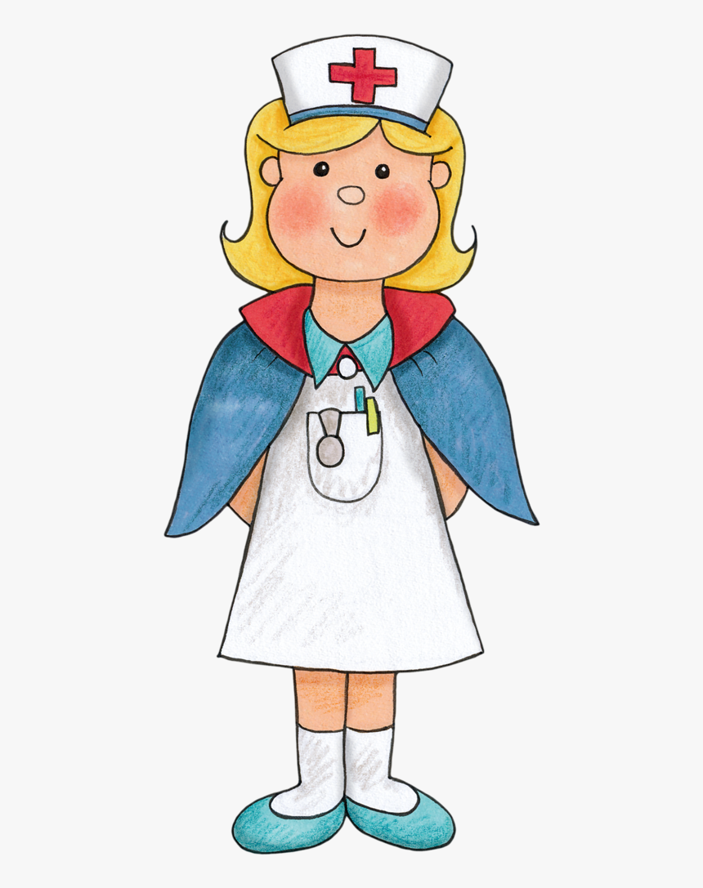

PEOPLE IN THE COMMUNITY

Slide 9

VALUE OUR COMMUNITY HELPERS
Community helpers are
part of our everyday lives

Slide 10
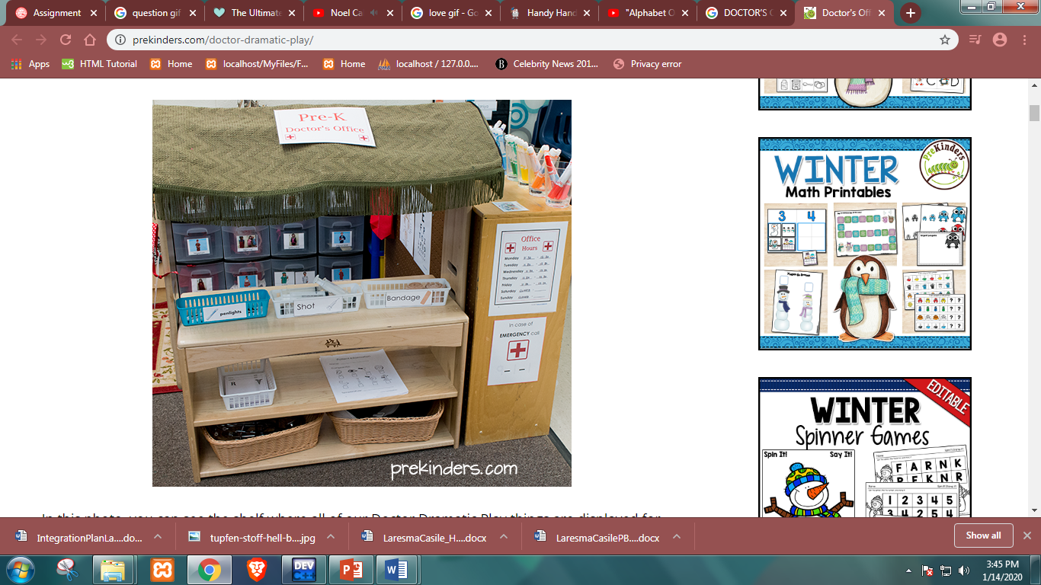
ACTIVITY 1 : DOCTOR’S OFFICE
DRAMATIC PLAY
Group yourselves into five! In this activity, everyone will act as a community helper in the hospital and each one will use the equipment provided.

Slide 11

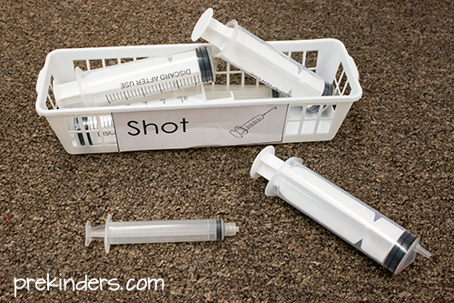
ACTIVITY 1 : DOCTOR’S OFFICE
DRAMATIC PLAY
MATERIALS:

Slide 12
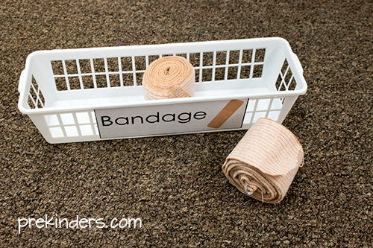
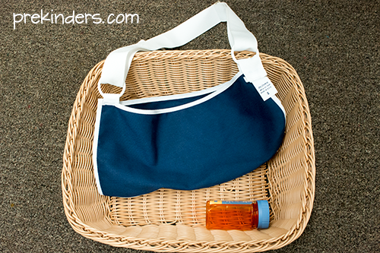
ACTIVITY 1 : DOCTOR’S OFFICE
DRAMATIC PLAY
MATERIALS:

Slide 13
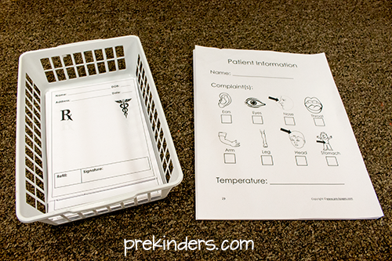
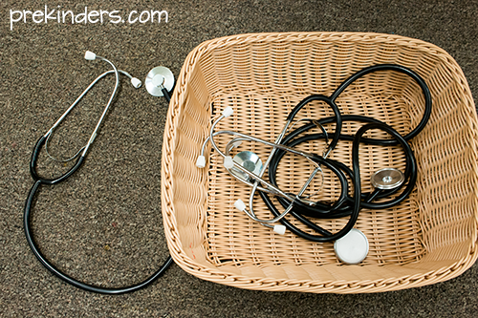
ACTIVITY 1 : DOCTOR’S OFFICE
DRAMATIC PLAY
MATERIALS:

Slide 14
PEOPLE IN THE COMMUNITY
THANK YOU FOR LISTENING!

